Slide 1
Object-Oriented Programming
What / Why OOP?
OOP Terminology
OOP in Python
Design Example
Encapsulation
Composition
Inheritance
Polymorphism
OOP
By Ryan Henning

Slide 2
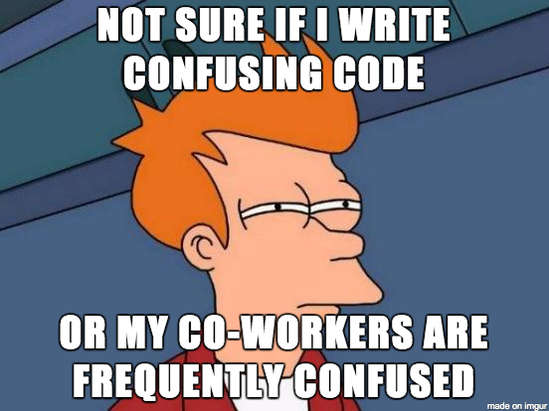
Why OOP?
Software Engineering is the topic today.
Goal is to write code that is:
split into logical components
easy to understand
easy to use / re-use
easy to modify
easy to maintain
easy to test
Notes:
“As a Data Scientist you’ll be writing and using a lot of code. Good Software Engineering is the key to being efficient. Good OOP is the key to good Software Engineering.”

Slide 3
OOP is a programming paradigm
Paradigm: a distinct set of concepts or thought patterns
Other programming paradigms:
Functional: no global state, deeply nested function calls
Imperative: explicit sequence of commands (often called sequential)
Procedural: like imperative, but also supports procedures (e.g., functions)
Declarative: declare the result you want, not how to obtain it (e.g. SQL)
…
Most programming languages offer a mix of paradigms.
Notes:
Some language borrowed from:
https://en.wikipedia.org/wiki/Paradigm
http://cs.lmu.edu/~ray/notes/paradigms/

Slide 4
What’s in a program?
“A program by any other name would smell as sweet.” - Shakespeare’s Juliet
Program = Data + Algorithm
For this presentation, we’ll say:
Program = State + Behavior
Notes:
Don’t get the joke? See: https://en.wikipedia.org/wiki/A_rose_by_any_other_name_would_smell_as_sweet

Slide 5

So, what is the OOP paradigm all about?
Group the program’s state and behavior inside objects and classes.
Inspired by how humans categorize and manipulate the physical world.
E.g. Consider the concept of “Mug”:
Mug has state: color, volume, location
Mug has behavior: drink, fill, refill, break, clean
What is the current state of this mug?

Slide 6




OOP Terminology: “Object”
An object is:
A collection of variables (the “state” of the object)
A collection of methods (the “behavior” of the object)
There are 5 “Mug” objects on this page. Each has distinct state, but the same behavior.

Slide 7
OOP Terminology: “Class”
A class is a category/blueprint for objects.
E.g. The previous slide showed 5 mug objects. Each of those 5 objects is an instance of the class: Mug. 5 objects, 1 class.

Slide 8
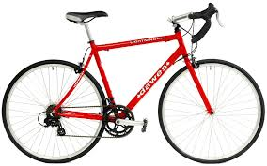




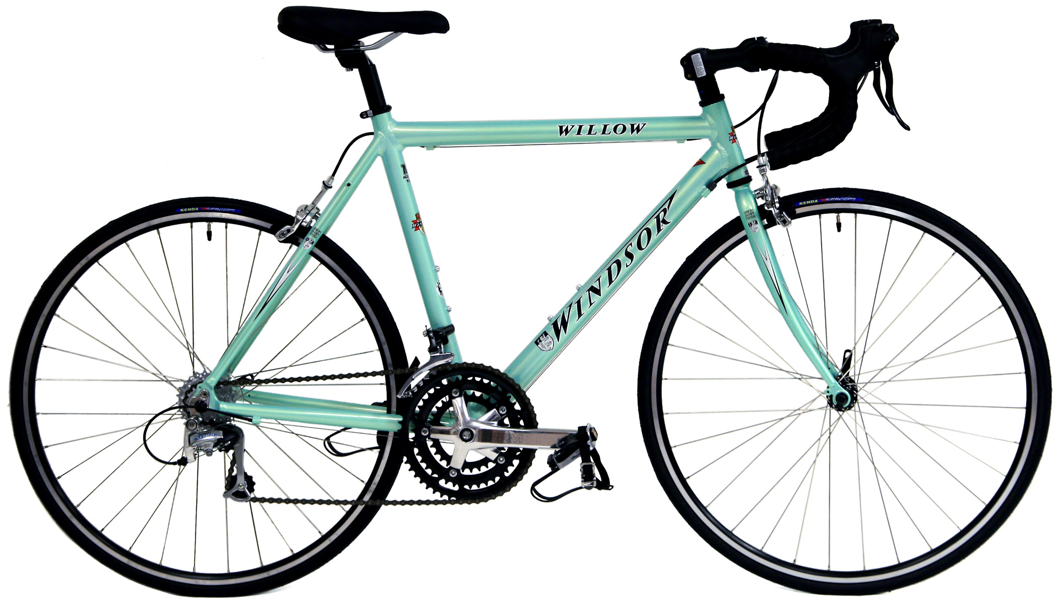



How many objects? How many classes?
Notes:
DO AN IN-CLASS POLL HERE TO CHECK FOR UNDERSTANDING! We poll on polleverywhere.com

Slide 9
OOP Terminology: “Member variable”
Every object has a set of member variables. Member variables are variables that are bound to that object and only that object. You can think of it like that object “owns” those variables.
An object’s member variables define that object’s current state.
Notes:
Member variables go by many names, other people call them: “instance variables”, “fields”, “attributes”, “properties”, etc. I don’t really care what you call them.

Slide 10
OOP Terminology: “Method”
Every object has a set of methods. Each method is a procedure that the object knows how to perform. Most of the time the methods will change the object’s state (i.e. modify the object’s member variables).
An object’s methods define that object’s behavior.
Notes:
In code, methods look a lot like functions. They act a lot like functions too! But please don’t call them functions, that’s a pet peeve of mine… procedures that operate on objects are called METHODS!

Slide 11
OOP in Python (quick review)
Review:
Python classes you use every day! (list, dict, string, …)
Declaring the Fraction class
Instantiating Fraction objects
Using Fraction objects
Magic methods

Slide 12
UML Class Diagram
UML: Unified Modeling Language
Camera
What are the parts of this class diagram?
is_open : boolean
input_port : string
open(ctl_port : string)
close()
capture() : image
Notes:
Class diagrams usually denote the access policy (public, private, protected), of each member/method. But python doesn’t enforce access policies, so I’ve left them off the diagram.

Slide 13
UML Class Diagram
UML: Unified Modeling Language
the class name
member variables
(the state of each object)
Camera
is_open : boolean
input_port : string
methods
(the behavior of each object)
open(ctl_port : string)
close()
capture() : image

Slide 14
Let’s design a program in OO fashion.
Smart Recycling Robot (SRR)
Build a robot that sorts physical objects into three categories:
recycle,
compost,
landfill
The robot brain is a computer program that you will write. The robot has an arm for grasping each piece of trash and delivering it to one of three bins.

Slide 15
Software Engineering: Designing the SRR
Nouns and Verbs
Capture frames from the camera.
Process frames.
Move the arm into position.
Grasp the trash using the arm.
Release the trash.
Loop the detection/action cycle.
Types of trash are: Recycle, Compost, Landfill, Empty
Notes:
Dashed arrow -- “uses”
Diamond arrow -- “composed of”
Notice the SVC is only held by the DecisionModule. That’s cool because it allows us to swap out the SVC for a different learning model by only updating the DecisionModule -- the change is very isolated and small. It gets even better... Later on, using polymorphism, we’ll be able to swap out the SVM by only changing one line of code!

Slide 16
Software Engineering: Designing the SRR
UML Class Diagram with Relationships
sklearn.svm.SVC
DecisionModule
...
Camera
fit(X, y)
predict(X)
is_open : boolean
input_port : string
Arm
process(frame : image) : Decision
current_position : tuple
is_grasping : boolean
is_open : boolean
ctl_port : string
open(input_port : string)
close()
capture() : image
<<enumeration>>
Trash
Controller
open(ctl_port : string)
close()
move_to(new_position : tuple)
grasp()
release()
Recycle
Compost
Landfill
Empty
loop_once()

Slide 17
Software Engineering: Designing the SRR
UML Class Diagram with Relationships
sklearn.svm.SVC
DecisionModule
...
Camera
fit(X, y)
predict(X)
is_open : boolean
input_port : string
Arm
process(frame : image) : Decision
current_position : tuple
is_grasping : boolean
is_open : boolean
ctl_port : string
open(input_port : string)
close()
capture() : image
<<enumeration>>
Trash
Controller
open(ctl_port : string)
close()
move_to(new_position : tuple)
grasp()
release()
Recycle
Compost
Landfill
Empty
loop_once()
Notes:
Dashed arrow -- “uses”
Diamond arrow -- “composed of”
Notice the SVC is only held by the DecisionModule. That’s cool because it allows us to swap out the SVC for a different learning model by only updating the DecisionModule -- the change is very isolated and small. It gets even better... Later on, using polymorphism, we’ll be able to swap out the SVM by only changing one line of code!

Slide 18
Python Demo: construct the SRR
OOP FTW in (at least) 3 ways: what are they?
Notes:
During the python demo, we’ll just show the stubbed out classes, then we’ll write main.py together.
Our code is readable. New people to the project shouldn’t be too confused.
If one class gets complicated, the other classes don’t need to know about it. The complexity is hidden away.
Easy to test. Test each class one at a time. Testing each method one-at-a time is called “unit testing”, which is possible with this code.
Easy to modify. Say you get a new type of arm. Easy, just modify the one class: Arm. Or say you get an additional arm of the same type. Pretty easy too: just instantiate a new arm and update the Controller so that the second arm is also used.

Slide 19
Encapsulation
Hiding the confusing details/complexity of your code inside a class.
Good because:
Code outside the class is safe (encouraged, even) to ignore the details inside the class.
The details/complexity inside the class are free to change without affecting the code outside the class.
Notes:
How does the SSR use encapsulation?

Slide 20
Encapsulation (example)
>>> import numpy as np >>> X = np.array([[-1, -1], [-2, -1], [1, 1], [2, 1]]) >>> y = np.array([1, 1, 2, 2]) >>> from sklearn.svm import SVC >>> clf = SVC() >>> clf.fit(X, y) >>> print(clf.predict([[-0.8, -1]]))
[1]
Notes:
There is a lot happening inside the SVC class, but we don’t have to know or care about it! We only reap the benefits.

Slide 21
Composition
Storing objects inside objects. The “has-a” relationship. Triangle has Points.
class Point: ... details omitted ... def calculate_distance(self, other_point): ... details omitted ...
if __name__ == '__main__': p1 = Point(0, 2) p2 = Point(4, 5) p3 = Point(3, 0) triangle = Traingle(p1, p2, p3) print triangle.calculate_perimeter()
class Triangle: def __init__(point1, point2, point3): self.point1 = point1 self.point2 = point2 self.point3 = point3 def calculate_perimeter(self): a, b, c = self.point1, self.point2, self.point3 return a.calculate_distance(b) + b.calculate_distance(c) + c.calculate_distance(a)
Notes:
How does the SSR use composition?

Slide 22
Morning Exercise
Modify an existing OOP-style program: The (card)game of WAR.

Slide 23



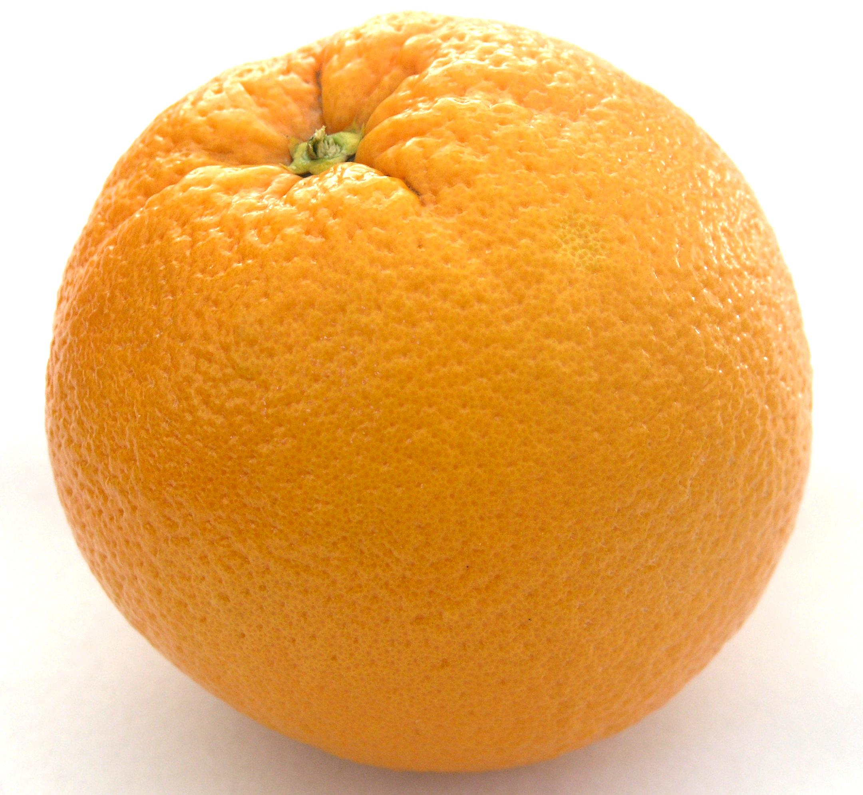



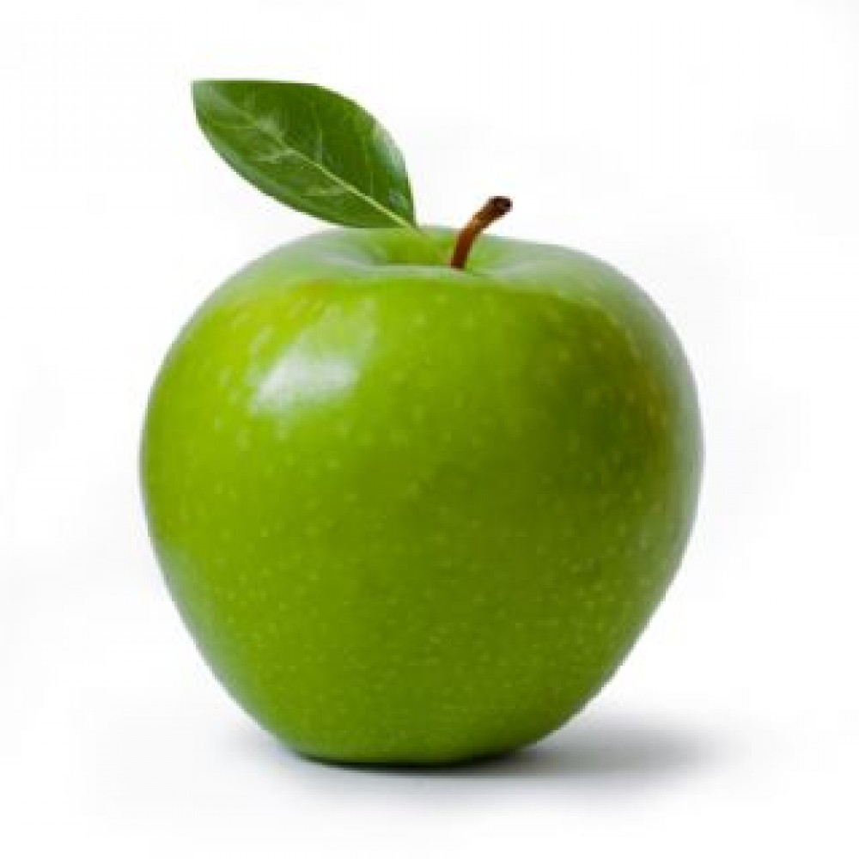

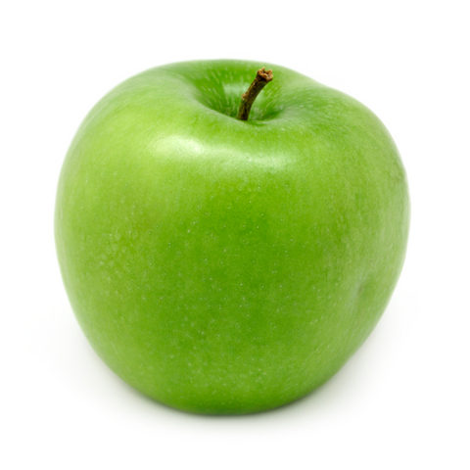


How many objects? How many classes?
Notes:
Object is easy: 12 object.
But classes? Uhh… maybe 1. Maybe 5… ?

Slide 24
Inheritance
The “is-a” relationship. Banana is a Fruit.
This is a silly example, we’ll see a serious example next.
Fruit
weight : float
“Parent” class:
grow()
eat()
Banana
Orange
Apple
“Child” classes:
peel(percentage : float)
peel()
wash()
Notes:
Parent class is also called the “base” class.
Child classes are also called “subclasses”.
Notice the arrow seems backwards if you think “Banana is derived from Fruit.” While that statement is true, the arrow is not trying to capture that idea. Rather the arrow captures the idea “Banana is-a Fruit.”

Slide 25
Polymorphism
Fruit
weight : float
“Parent” class:
grow()
eat()
Banana
Orange
Apple
“Child” classes:
peel(percentage : float)
eat()
peel()
eat()
wash()
eat()
Notes:
Fruit implements the default way to eat a fruit.
Banana, Orange, and Apple “override” the eat() method to define their own ways to be eaten.

Slide 26
Inheritance/Polymorphism
in Python
Fruit / Banana / Orange / Apple
Notes:
Start with the code implementing the design in the “Inheritance” slide. Override the eat() method to become the design in the “Polymorphism” slide.

Slide 27
Polymorphism in sci-kit learn
sklearn.base.ClassifierMixin
...
fit(X, y)
predict(X)
score(X, y)
sklearn.linear_model.LinearRegression
sklearn.linear_model.LogisticRegression
sklearn.svm.SVC
...
...
...
fit(X, y)
predict(X)
score(X, y)
fit(X, y)
predict(X)
score(X, y)
fit(X, y)
predict(X)
score(X, y)
Notes:
Technically… ClassifierMixin doesn’t declare the fit() and predict() methods. It only declares the score() method. It’s my believe that sklearn SHOULD have ClassifierMixin declare all three methods. On sklearn’s website it does say explicitly (in English prose, not in code) that all classifiers will implement the fit() and predict() methods. So… I think it might be an oversight in the ClassifierMixin’s declaration. But with Python’s duck typing, it doesn’t really matter anyway.

Slide 28
Notes about Python convention
Classes:
Class names are nouns.
Class names must begin with a capital letter.
Methods:
Method names are (usually) verbs.
Method names begin with a capital letter.
Method names that begin with an underscore should be treated as “private”.

Slide 29
Testing code via mock objects
(in python)
Testing the Controller.

Slide 30
Afternoon Exercise
Simulate the game of Blackjack in an OOP-style program.

